Slide 1
Azure OpenAI in Foundry Models

Slide 2

Announcing
Model Router in Azure AI Foundry Models | Public Preview | Choose the right LLM for your diverse use cases
Azure AI Foundry Provisioned Throughput | Public Preview | Deploy and reserve capacity across Azure AI Foundry Models
Monitoring Dashboard |  | Provide real-time insights into usage, performance, and compliance of your resources
Provisioned Throughput Dynamic Spillover | Public Preview | Manage traffic bursts without service disruption
Prompt Caching | Public Preview | Accelerates response times, scales throughput, and cuts token cost
Batch Dynamic Quota |  | Up to billions of tokens accelerate massive batch requests processing
Public Preview
Public Preview

Slide 3
Model Router in Azure AI Foundry Models
Public Preview
Choose the right LLM for your diverse use cases
Dynamic routing
Simplified integration
Optimized compute cost

Slide 4
Azure AI Foundry Provisioned Throughput
Public Preview
A single PTU across different models
Optimized
model switching
Simplified operation
Scale with cost-efficiency
Notes:
Enhanced Compliance: DataZone deployments ensure that data processing and residency requirements are met by allowing customers to process data within specific regions. This is particularly beneficial for organizations with stringent compliance needs.
Improved Scalability: By leveraging Azure's robust infrastructure, DataZone deployments enable customers to scale their AI solutions efficiently. This ensures that businesses can handle increased workloads without compromising performance.
Increased Security: DataZone deployments provide a secure environment for data processing, helping to protect sensitive information and maintain data integrity. This is crucial for organizations that prioritize data security.

Slide 5
Azure OpenAI Monitoring Dashboard
Public Preview
Track performance, usage, and reliability across your deployments
Unified visibility
Zero in on
key metrics
Developer-friendly tooling & access
Notes:
Azure OpenAI provides two out-of-the-box dashboards:
Azure Portal Overview Pane: High-level metrics for each OpenAI resource.
AI Foundry Metrics Dashboard: Deep-dive into operational telemetry, accessible via the Azure AI Foundry portal
Dashboards are organized into four core metric groups:
HTTP Requests: Tracks request volume, success/failure rates, and latency.
Token-Based Usage: Monitors token consumption by model and deployment.
PTU Utilization: Visualizes provisioned throughput usage and capacity trends.
Fine-Tuning: Observes fine-tuning job progress, errors, and token usag
You can access and analyze monitoring data using:
Azure Portal
Azure Monitor
PowerShell, CLI, REST API
Azure SDKs and client libraries

Slide 6
Dynamic Spillover
Public Preview
Seamless Overflowing for your high-performing applications
Avoid 429s and downtime
Tack and tune with confidence
Cost-efficient scaling
Notes:
Avoid 429s and downtime. Spillover automatically routes overflow traffic from provisioned deployments to PAYG endpoints—ensuring uninterrupted service during traffic spikes. No 429s. No stress. Just Spillover.
Use Azure Monitor to visualize when and how Spillover activates, helping you optimize deployment sizing and cost.
Provision for your average load and let Spillover handle the peaks—no need to overpay for unused capacity.

Slide 7
Prompt Caching
Public Preview
Built-in optimization for repeatable prompt patterns
Reduce latency with faster time-to-first-token
Increase cache hit rate and throughput
Cached tokens costs 50% less
Notes:
Performance Acceleration: Prompt caching reduces latency by reusing previously computed token prefixes. This means faster time-to-first-token, especially for streaming requests—ideal for chat and real-time applications
Scalable Efficiency: By optimizing prompt structure (e.g., placing static content at the beginning), developers can increase cache hit rates and throughput. This enables smoother load testing and more predictable performance under scale
Cost Optimization: Cached tokens are billed at a 50% discount in Global Standard and Standard SKUs. This makes prompt caching not just a performance win, but a budget-friendly one

Slide 8

Large Scale workload support in batch! Scaling your massive batch queries with minimal friction
Dynamic Quota
Dynamic quota lets you queue more than your quota—ideal for multi-day runs
10,000 File Limit
Now queue up to 10,000 files—a 20x increase powered by file expiry
Bring Your Own Blob (BYOB)
Skip uploads—use Azure Blob Storage directly
Smarter Programming Constructs
Fail-fast workflows for easier, resilient job handling
Made for scale
No more file/token bottlenecks
Streamlined input and reduced prep time
Easier dev experience with simplified constructs
Notes:
Dynamic quota lets you more than your quota – ideal for multi day runs
10,000 File Limit Now queue up to 10,000 files — a 20x increase powered by file expiry
Bring Your Own Blob (BYOB) Skip uploads – use Azure Blob Storage directly
Smarter Programming Constructs Fail-fast workflows for easier, resilient job handling
No more file/token bottlenecks
Streamlined input & reduced prep time
Easier dev experience with simplified constructs
Get Started Today with gpt-4.1 (more models coming soon)
in both Global and Datazone offerings
🔜 Coming Soon: Expanded model support

Slide 9

New for fine-tuning
Azure AI Foundry
We’re making every aspect of fine-tuning better.
New models and techniques
Enterprise promises
Developer tier
Availability
GPT-4.1, 4.1-mini, 4.1 nano
o4-mini reinforcement fine-tuning
Llama 4
Experiment with ease— no hosting fee
Global training for OpenAI models
US data zone for OSS models
PTU-M GA Global Deployment GA Extended support for retired models
AI.Azure.com
Notes:
Support for three new models: GPT-4.1-nano, o4-mini, and Llama 4 in Azure AI Foundry Models. Also, a new fine-tuning technique—Reinforcement fine-tuning.
“Fine-tuning isn’t just for the experts: Upload domain data or even give feedback in the playground; get a custom model that’s actually tailored to your business—without the rocket science.”
“Only on Azure can you both pick from this many models and fine-tune OpenAI’s latest directly with built-in cost controls.”

Slide 10
Azure AI Foundry | AOAI Build Sessions
Date | Time | Session link
Monday, May 19 | 4:30pm – 5:30pm PT | BRK 173 Advanced Azure OpenAI Innovation in Azure AI Foundry​
Tuesday, May 20 | 3:00pm – 4:00pm PT | BRK150 Fine-tuning and distillation with Azure AI Foundry​
Wednesday, May 21 | 3:30pm – 4:30pm PT | BRK178 Optimize your GenAI applications at scale in Azure AI Foundry
Wednesday, May 21 | 5:00pm – 6:00pm PT | BRK170 Revolutionizing AI Apps with Multimodal Models in Azure AI Foundry​

Slide 11
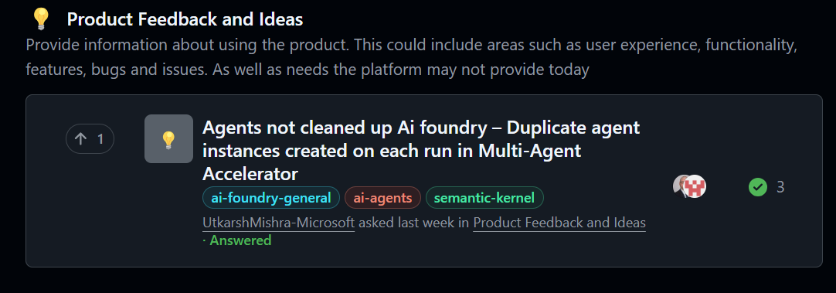
Azure AI Foundry | Feedback collection process
https://aka.ms/AI/Feedback

Slide 12


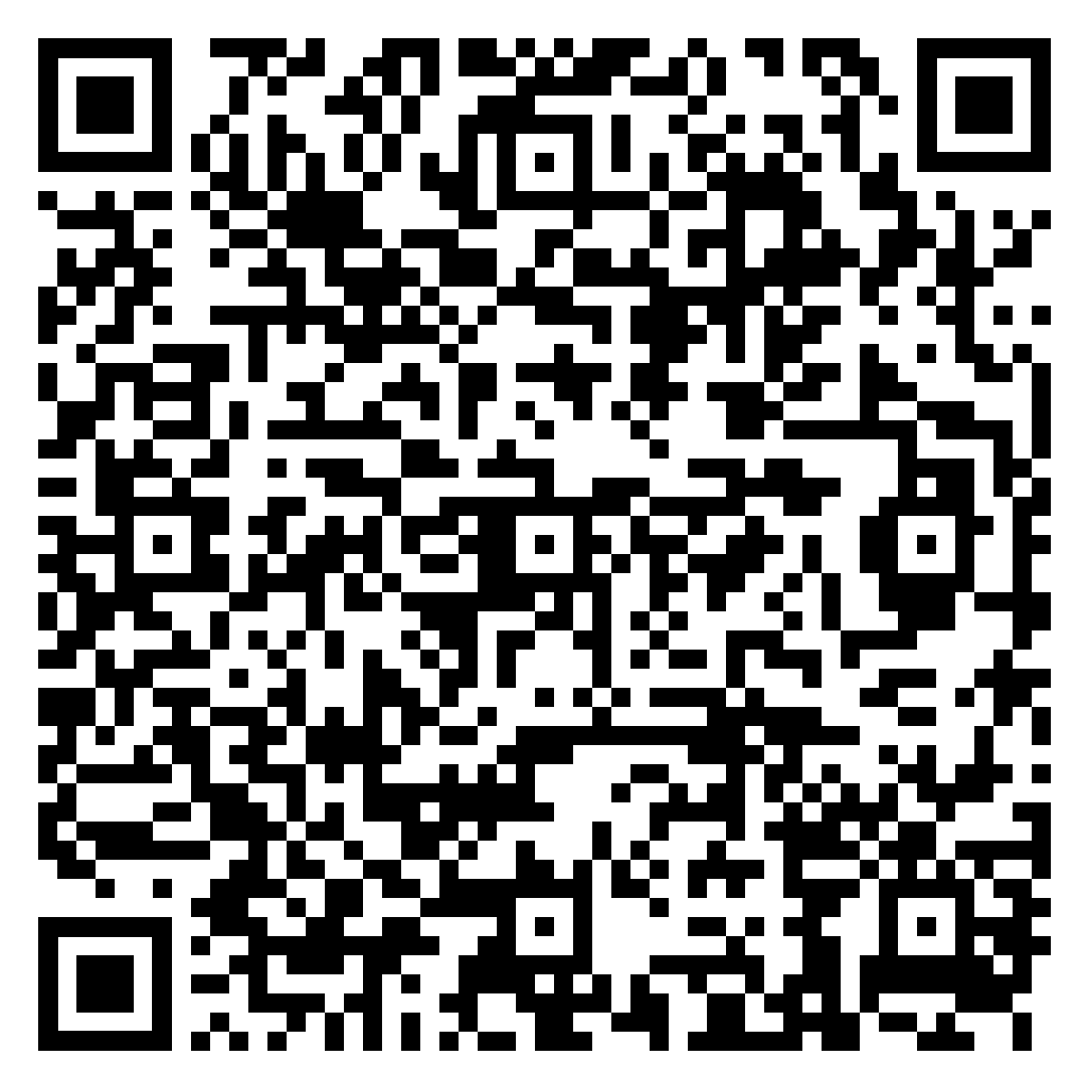
Azure AI Foundry
Leave a product review, get $25!
Share your insights using Azure AI Foundry. Help other developers and become a thought leader.
Choose a $25 gift card as a “thank you” for your time.
Any technical roles, from VPs to developers, can leave a review. Must be a real customer of Azure AI Foundry.
https://aka.ms/leaveareview

